Slide 1
Introduction to Game AI Workshop
Session 1: Steering Behaviors
https://github.com/jharger/AIWorkshop

Slide 2

Workshop Plan
Intro & Steering Behaviors
Behavior Trees
Path Finding
Planning

Slide 3
Agent-based Simulation
Each entity/character/creature is an “agent”
Each agent is independent of all others
Has its own knowledge and memory
Makes its own decisions based entirely on its own info
However, an agent may be given information or orders from other agents

Slide 4
Layered Approach
Higher-level Cognitive
Goals, desires, path-finding, knowledge, memory
Mid-level Functions
Local navigation, obstacle avoidance
Lower-level Neurological
Movement/locomotion, animation

Slide 5
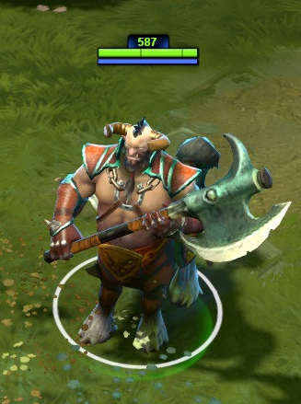
MOBA Character Example
AIMOBACharacter
PlayerMOBACharacter
Potentially shared code:
Move somewhere
Attack someone
Use skill(s)

Slide 6
MOBA Character Example
AIMOBACharacter
PlayerMOBACharacter
Animator
Locomotion
Game Mechanics

Slide 7
MOBA Character Example
AIMOBACharacter
PlayerMOBACharacter
Steering Behaviors
Animator
Locomotion
Game Mechanics

Slide 8
MOBA Character Example
AI Controller
KB/Mouse Controller
Path Finding
Steering Behaviors
Animator
Locomotion
Game Mechanics
(skills, etc)
Modularized our Shared code yaaaay!

Slide 9
What are steering behaviors?
First presented at GDC 1999.
They give agents “the ability to navigate around their world in a life-like and improvisational manner.”
Individually, these behaviors are very simple, but they can be combined to achieve higher level goals.
http://www.red3d.com/cwr/steer/

Slide 10
UnitySteer
https://github.com/ricardojmendez/UnitySteer

Slide 11
Under the Hood
Simple locomotion formulas:
steering_force = truncate (steering_direction, max_force) acceleration = steering_force / mass velocity = truncate (velocity + acceleration, max_speed) position = position + velocity

Slide 12
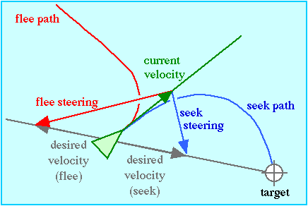
Seek and Flee
Seek - Move toward target position
desired_velocity =
normalize (position - target) * max_speed
steering =
desired_velocity - velocity
Flee - Move away from target position
desired_velocity =
-(normalize (position - target) * max_speed)
steering =
desired_velocity - velocity

Slide 13
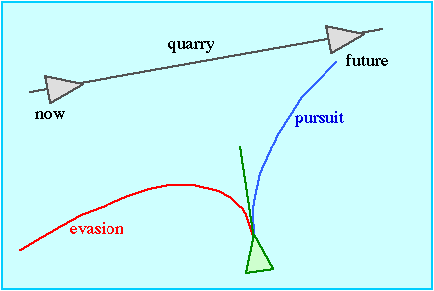
Pursuit and Evade
Pursuit - Move toward where target will be
Evade- Move away where target will be

Slide 14
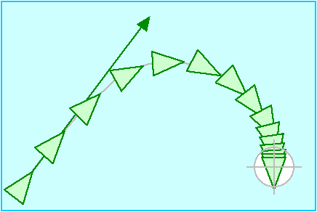
Arrival
Approach a target position, and slow down as you arrive
target_offset = target - position distance = length (target_offset) ramped_speed = max_speed * (distance / slowing_distance) clipped_speed = minimum (ramped_speed, max_speed) desired_velocity = (clipped_speed / distance) * target_offset steering = desired_velocity - velocity

Slide 15
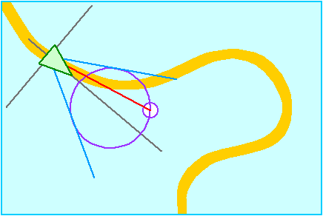
Wander
Move around in a semi-random fashion, by Seeking a position on a virtual circle in front of the agent. The position on the circle is randomly displaced over time.

Slide 16
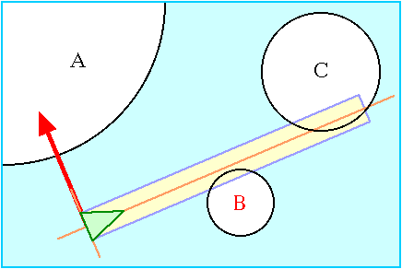
Obstacle Avoidance
Changes steering direction to avoid obstacles represented as bounding spheres.
Note that if several bounding spheres are clustered together and form a non-convex object, obstacle avoidance may cause the agent to get stuck!

Slide 17
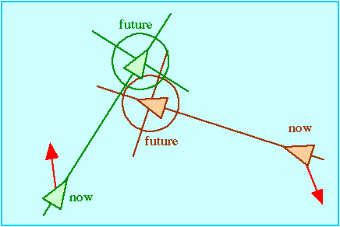
Unaligned collision avoidance
Steers an agent away from a future collision.

Slide 18
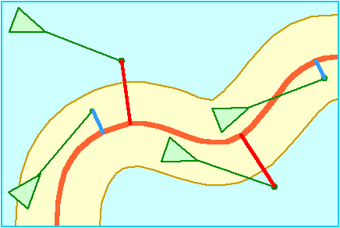
Path Following
Can follow a path without backtracking. This is especially useful after we cover Pathfinding.

Slide 19
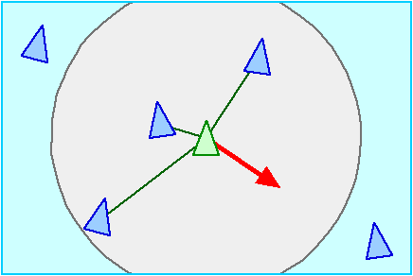
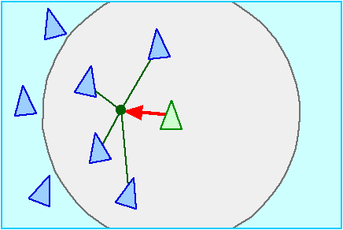
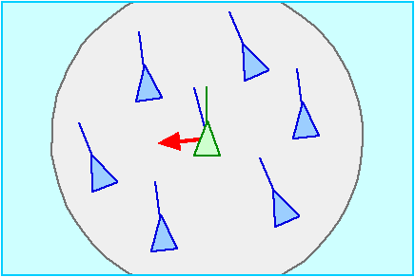
Components of Flocking
Separation
Agent keeps a minimum distance from neighbors
Cohesion
Agent keeps a maximum distance from centroid of neighbors
Alignment
Agent aligns itself in the same direction as neighbors
https://www.youtube.com/watch?v=g0LwS4ysGbE

Slide 20
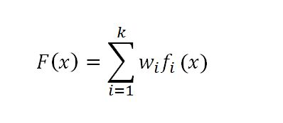
How do you combine them?
Simple answer: a weighted linear sum
steering_direction = w₀ * steering₀
+ w₁ * steering₁
...
+ w_{n} * steering_{n}
Sometimes, though, they may cancel each other out, or one overpowers another, etc. You may have to play with different weights until you find something that works.

